Slide 1
Bias in Data Analytics
Notes:
In this video, we’ll learn about the potential biases that can be found when analyzing data.

Slide 2

Review: Bias in Data
Joy Buolamwini
Computer Scientist
Algorithmic Justice League Founder
Source: https://www.insurancejournal.com/news/national/2019/04/08/523153.htm
Notes:
We learned in a previous lesson that programs can be biased based on a lack of data or an imbalance of the amount of data available for certain demographic groups. Even though computers are not human, they are still programmed by humans and are susceptible to bias.

Slide 3
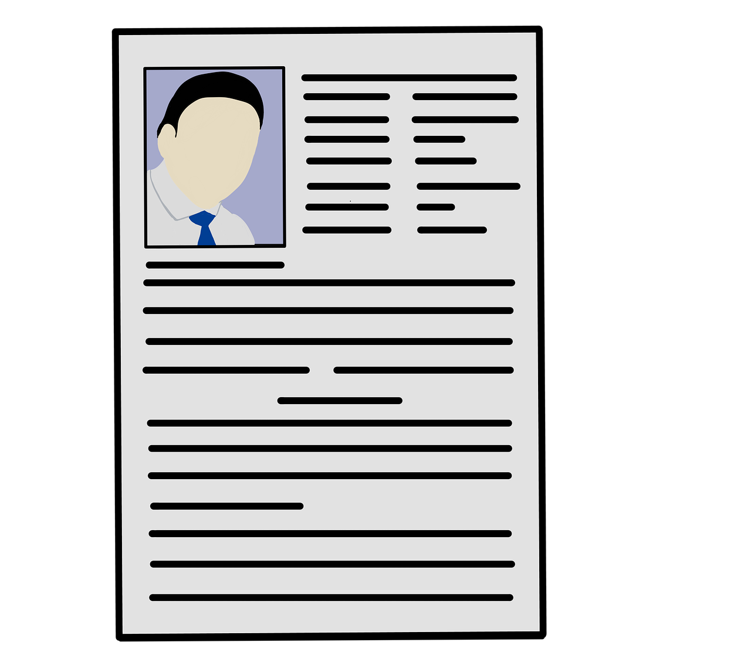

Bias in Recruitment
“fraternity”
“head coach”
“fishing charter”
Notes:
Another well known example is a bias data algorithm that was being used by Amazon as a recruitment tool. They discontinued using it after they discovered a gender bias. The data used in this case was taken from resumes that were submitted to Amazon over a 10 year period. However, most of these resumes were were written by males - and more specifically white males. The algorithm used machine learning and was taught to recognize word patterns in the resumes, rather than looking at skills and experience. Because of this, any word or phrase that was associated with the male gender, like fraternity, or a connection to sports and certain social activities bumped a resume up the line...

Slide 4

Bias in Recruitment
“sorority”
“Bennett College for Women”
Notes:
... while any word associated with females like sorority or the name of a women’s college penalized the resume.

Slide 5
Bias in Data Analytics
Incomplete datasets
Datasets lacking a diverse representation
Lack of context regarding the dataset
Incorrect use of data
The data that is missing may tell as important of a story as the data that is there.
Notes:
There are many ways that bias can creep into data analysis. If the dataset is incomplete, this would cause the analysis to be inconclusive as well. Datasets that lack a diverse representation or context make ways for potential bias no matter how good the analysis is. If the data is incomplete, or bad, then the analysis is incomplete or bad. The data in a dataset can also be used incorrectly, like in the recruitment algorithm. The choice to use and analyze word phrases instead of skills and experience was a main part in the gender bias that followed. Basically, it’s important to know that the data that is missing may tell as important of a story as the data that is there.

Slide 6
Review: Bias in Data
Bias in Statistical Questions
Do you prefer news or mindless sitcoms?
Notes:
We’ve learned about a lot of ways bias can show up in the different stages of the data life science cycle. There can be bias in the way a statistical question can be asked.

Slide 7

Review: Bias in Data
Bias in Statistical Questions
Do you prefer news or mindless sitcoms?
Bias in Data Collection
Confirmation bias: seeking out only data so that supports your beliefs
Lack of representation
Notes:
We learned about confirmation bias or just finding data that supports your own beliefs about the study. There can also be a lack of representation in the data that is collected.

Slide 8
Review: Bias in Data
Bias in Statistical Questions
Do you prefer news or mindless sitcoms?
Bias in Data Collection
Confirmation bias: seeking out only data so that supports your beliefs
Lack of representation
Bias in Data Cleaning
Missing Data
Outliers
Notes:
We also learned that data scientists make a lot of decisions during the data cleaning step of data collection. Every one of the decisions opens a door for potential bias. Decisions that are made about what to do with missing data or outliers should not be done in isolation and should be well-documented.

Slide 9

Interpretation Bias
Interpretation bias is the tendency to interpret situations and analysis in a positive or negative fashion.
“About how fast were the cars going when they bumped?”
“About how fast were the cars going when they smashed?”
Elizabeth Loftus
Cognitive Psychologist
Notes:
Another bias to consider is interpretation bias. This is similar to the bias found when posing a statistical question and can show up during the interpretation stage of the data science life cycle. There’s a famous study regarding interpretation bias. Elizabeth Loftus, a cognitive psychologist carried out research where she showed a film of car crashes to participants. Then, she split them into groups and separately asked them several questions about the car crashes. The questions were the same except for a simply change in the verbs used for each group. For example, one of the questions asked was “About how fast were the cars going when they bumped” as “About how fast were the cars going when they smashed”. To her surprise, the choice of verb had a huge impact on their estimates. Those who were told they “smashed” guessed higher speeds, as compared to those who were told they “bumped”. This is important to remember when you are interpreting or presenting data. You’ll want to be aware of what words you’re using.

Slide 10

Avoiding Bias
Don’t work in isolation.
Work with others on your research.
Verify with multiple data sources.
Ask a friend to review your results.
Notes:
A rule of thumb for avoiding bias is to make sure that you don’t work in isolation, as much as possible. Work with others when you can during all phases of the data science life cycle. Check for and use multiple data sources to compare and verify instead of just referencing one dataset. And reach out to others to review your results. All of these strategies will help limit bias from creeping into your study.

Slide 11
Lesson Vocabulary
Term | Definition
interpretation bias | The tendency to interpret situations and analysis in a positive or negative fashion.

